Slide 1
Chapter 1
Introduction
Conceptualization of Security, Forensics, and Privacy of Internet of Things: An Artificial Intelligence perspective

Slide 2

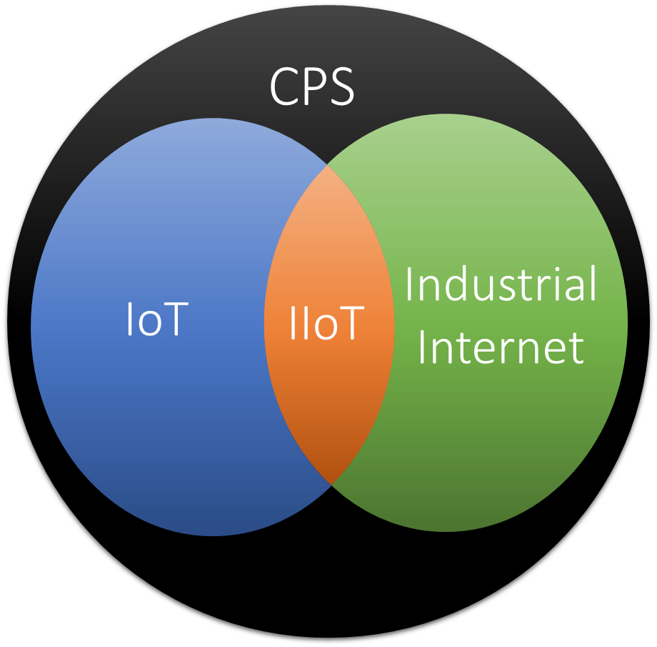
Cyber-physical Internet of Things

Slide 3
Security of Internet of Things
misunderstanding between IoT security and conventional cybersecurity
cybersecurity is generally identified as a technology pile of methods, protocols, and procedures to protect computing systems (software, application, services), network infrastructure, and data against malevolent attacks, intrusions, unauthorized access, and other categories of damage.

Slide 4
Forensics of Internet of Things
Digital Forensics (DF) is considered as a part of the conventional forensics science that mainly considers the discovery and analysis of digital or computerized data.
The Digital Forensics specialists deal with the recognition, compilation, retrieval, analysis, and maintenance of digital evidence discovered on a variety of electronic devices

Slide 5
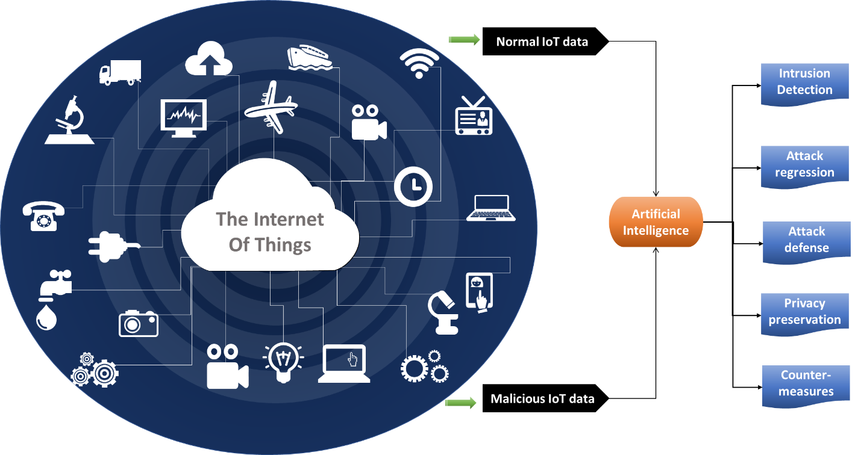
Artificial intelligence for Secure Internet of Things

Slide 6
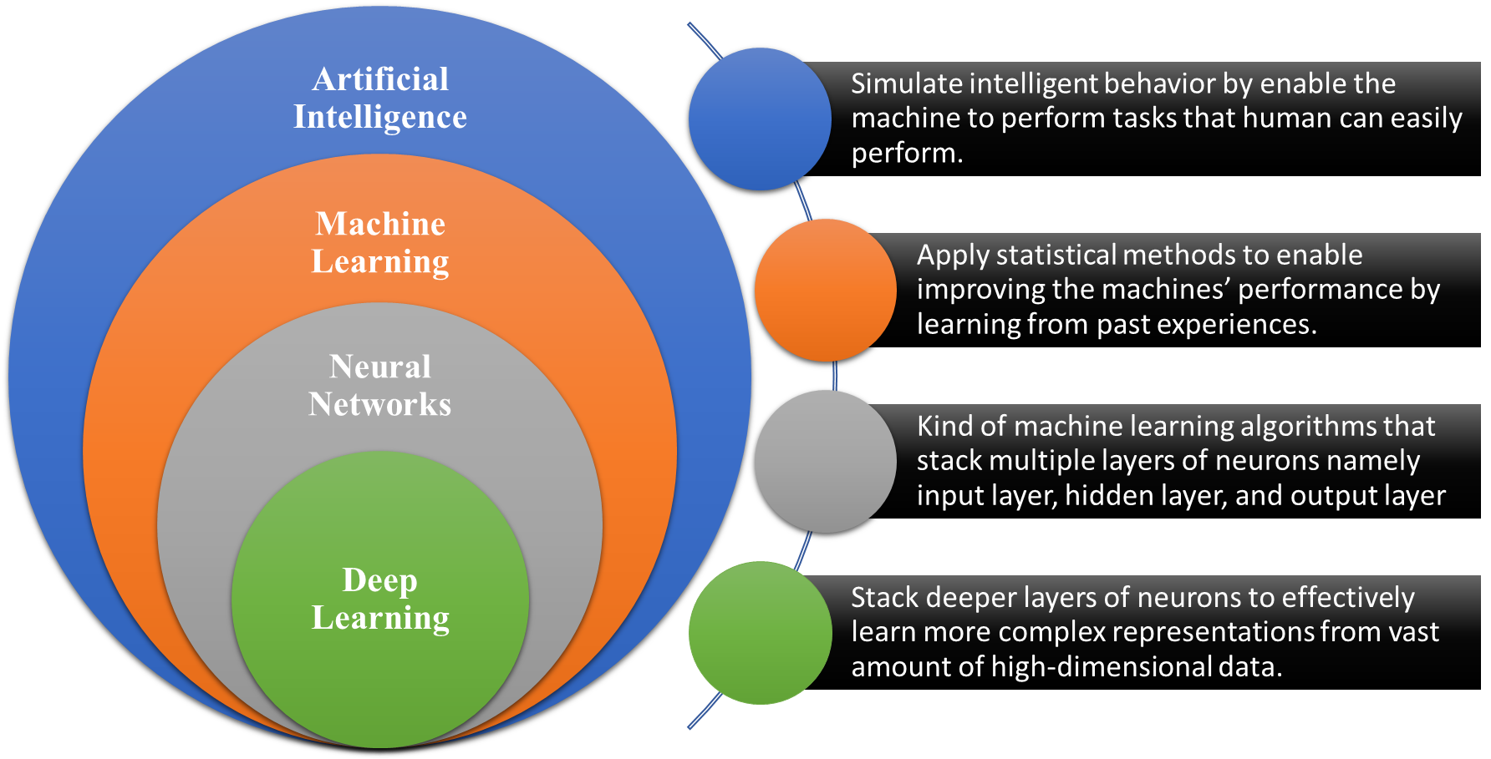
Artificial intelligence for Secure Internet of Things

Slide 7
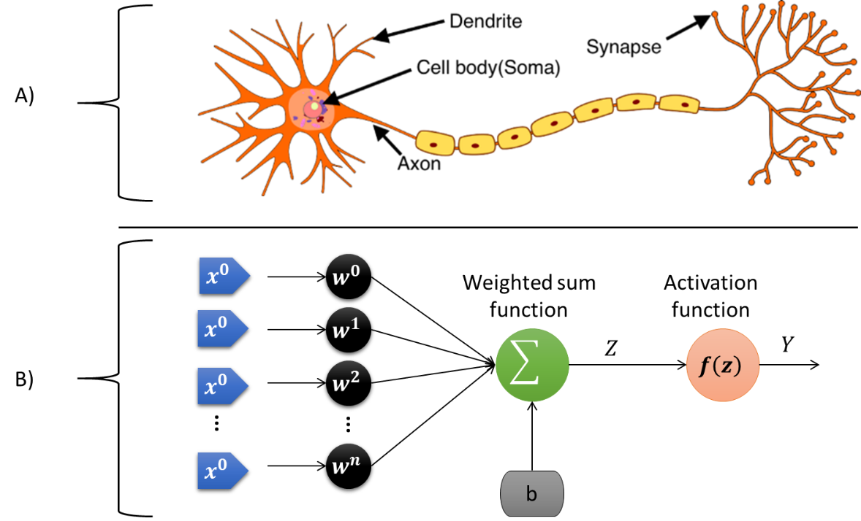
Artificial intelligence for Secure Internet of Things

Slide 8
Artificial intelligence for Secure Internet of Things

Slide 9
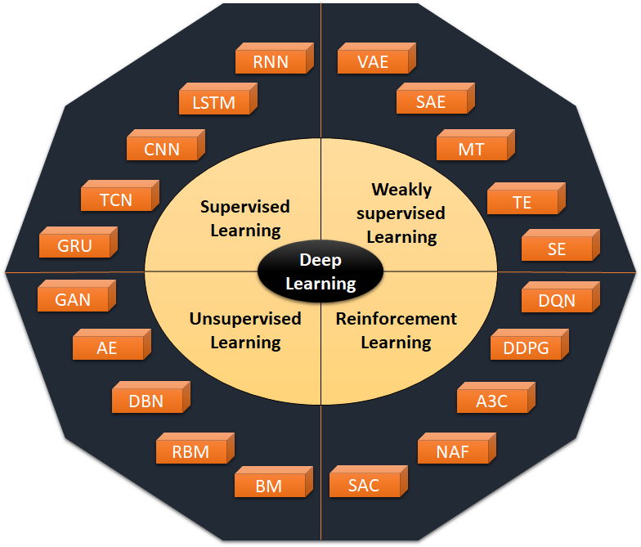
Artificial intelligence for Secure Internet of Things

Slide 10
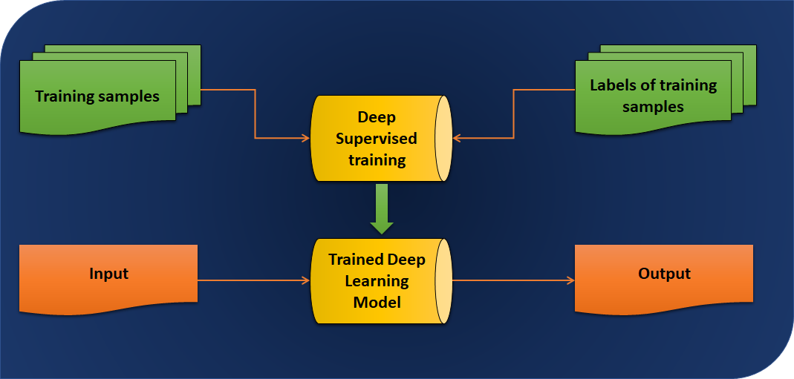
Artificial intelligence for Secure Internet of Things

Slide 11
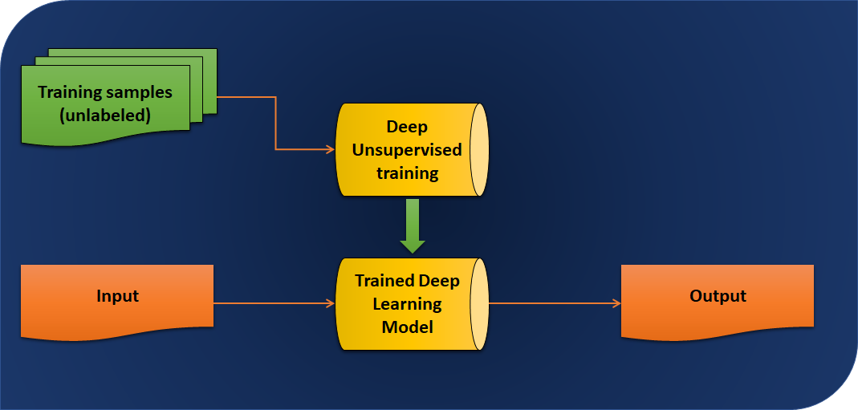
Artificial intelligence for Secure Internet of Things

Slide 12
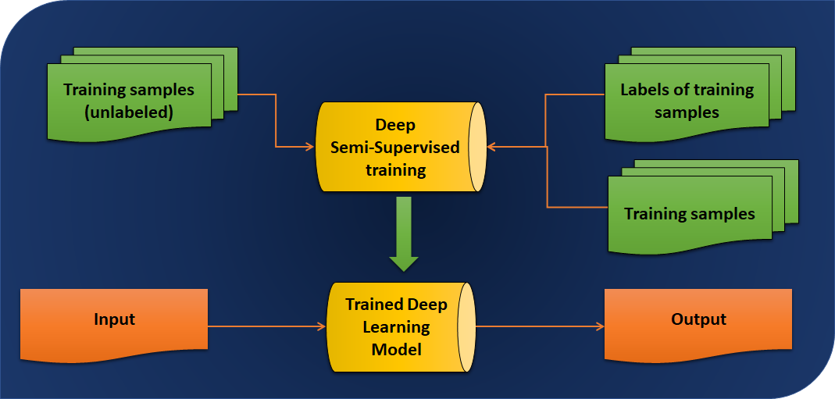
Artificial intelligence for Secure Internet of Things

Slide 13
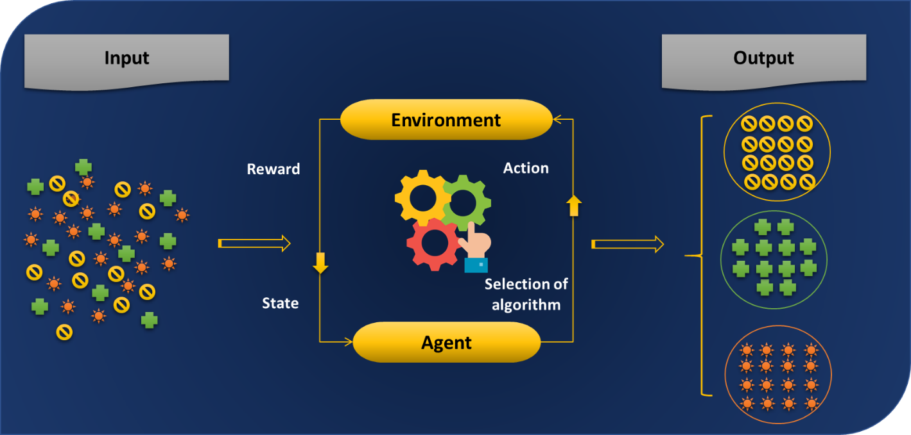
Artificial intelligence for Secure Internet of Things

Slide 14
Privacy in Internet of Things
The word “privacy” originates from the old French term “privaut´e”, which implies confidentiality, mystery, secrecy, or isolation.
The concept of Privacy has an extended history of definitions and implications.
One of the major motives behind the privacy interest in IoT environments is the thriving of deep learning, which enables developing models to learn from IoT data to offer intelligent solutions that can enhance the functionality or the security of the underlying system

